Slide 1
Portable Sensing Field Device
Group 4:
Joel Yello
Khoa Nguyen
Dawson Brown
Robert Pribyl

Slide 2
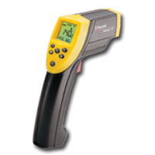
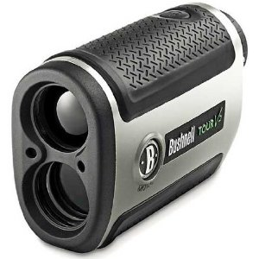
Goals
Laser-Based Rangefinder
IR Contactless Temperature Sensor
Combine both functions into one light-weight, handheld device activated by a trigger.
Provide simultaneous range and temperature readings via a 16x2 LCD output.

Slide 3
Motivation
New to optical systems
Group interest in laser technology and infrared technology
Combines 2 tools used every day
Lightweight
Small form-factor
Easy to read
Low power consumption
Time of Flight ranging is a challenge

Slide 4
Specifications
Ranging from 1-50 meters
<+/- 1 meter accuracy in subsequent measurements
Temperature readings from 0-5 meters
<+/- 2 degree accuracy in subsequent measurements
Device should weigh in between 1.5 and 2.5 pounds for portability.
LCD must simultaneously display temperature and range when triggered.

Slide 5
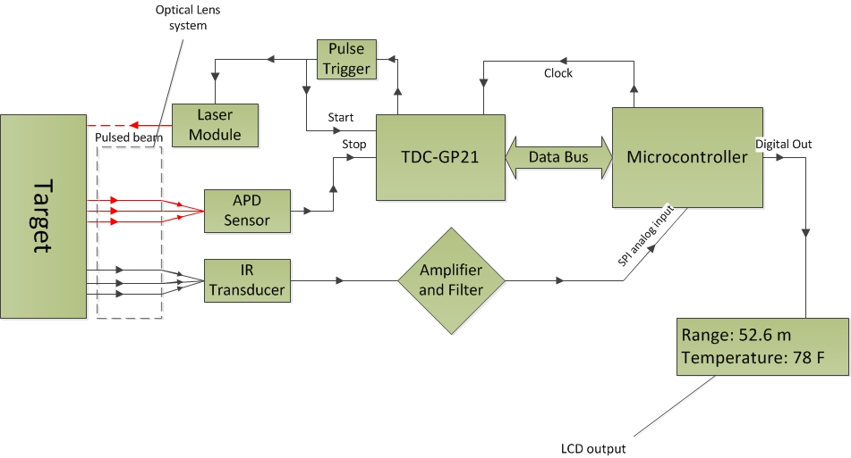
Block Diagram

Slide 6
Power
Each individual part of our device operates in a range between 3.3 and 140 volts.
Our high voltage supply needs to supply 140 volts. It supplies 400V at 12V, and through testing we have determined it can run 140V at ~5 volts.
Our device must remain portable, limiting our options for selecting a power source.
We have chosen a series of linear voltage regulators to obtain the different voltages we need. All regulators operate in a temperature range of 0-125 degrees Celsius.
Because of this, we must ensure that the heat dissipated on the regulator doesn’t exceed a stable operating environment. The equation to determine power dissipation is as follows:
Pdis = (Vin – Vout) * Iout

Slide 7
Source Options cont.
Nickel Cadmium
Low voltage per cell (1.2V)
Lower cell density in comparison to Lithium-Ion
Dangerous technology, cadmium is hazardous to all life forms.
7+ volt pack will take 6+ batteries and generally weigh in at nearly a pound or more and the area is also 3 times larger than the equivalent lithium ion pack

Slide 8
Source Options
Nickel Metal Hydride
Low cell voltage (1.2V)
Cell density between 2 and 3 times that of an equivalent nickel cadmium cell
Environmentally safe due to the absence of cadmium
Very high self discharge rate (5-10% on first day, .5-1% per day after)
A 7.2 volt pack consists of 6 individual cells, weighing in at 8 ounces and takes up 3 times the area of the equivalent lithium ion pack.

Slide 9
Source Options cont.
Lithium Ion (chosen battery technology)
High voltage per cell (~3.7V)
High cell density in comparison to other technology
Very slow self discharge rate
Volatile technology, can catch fire under bad conditions and upon contact with water
Less cells to obtain desired voltage, results in smaller design

Slide 10
Source Options cont.
9 volt lithium-ion battery
600mAh
~1.5-2.0 hours of operation
9 volts, in operating range of all parts, 4 volts minimum lost over regulators
Built-in overcharge/discharge protection circuit
Comes paired with a charger
Lightweight, single cell battery
7.2 volt lithium-ion battery pack (chosen battery)
750 mAh
~1.5-2.5 hours of continued operation
7.2 volts, in operating range of all parts and not a lot of wasted voltage
Battery charger available
Lightweight, 2 AA cell pack, 1.6 ounces

Slide 11
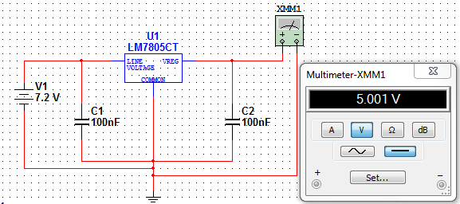
LM7805
The 7805 operates between 7 and 25 volts, proper for our power source.
Since our supply is 7.2V, there are no concerns in heat production from the voltage difference
The 7805 is used to power the transimpedance amplifier, temperature sensor amplifier, and Arduino development board.

Slide 12
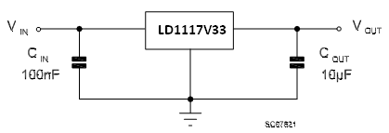
LD1117V33
The LD1117V33 operate between 5 and 15 volts, proper for our source
Dropping 7.2V to 3.3 volts will produce quite a bit of heat, so its possible that we will add a leading resistor to drop the voltage, or apply a heatsink to the regulator
The LD1117V33 will be used to power the TDC GP21

Slide 13
Ranging - Design Considerations

Slide 14
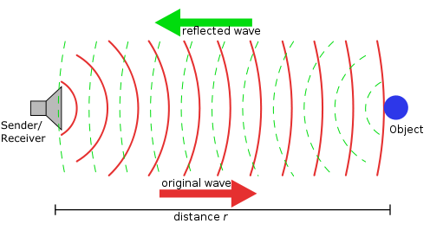
Design Considerations
Methods of Ranging considered
SONAR (ultrasonic)
Cheapest to implement
Easy to use
Distance limited to less than 10m
RADAR
Can achieve very far distance readings
Does not bounce off all objects
LIDAR (Laser\infrared)
Best choice: Line of sight ranging and will reflect at least some light off almost all surfaces.
Our design will use the time of flight method

Slide 15
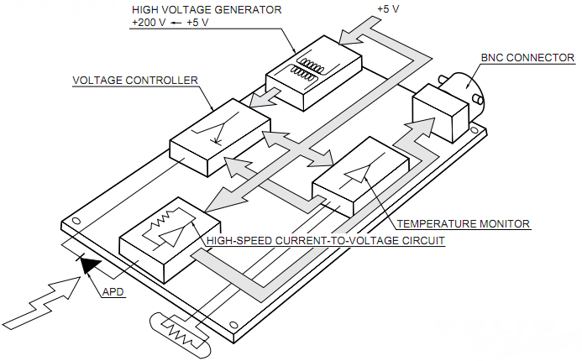
APD Module

Slide 16
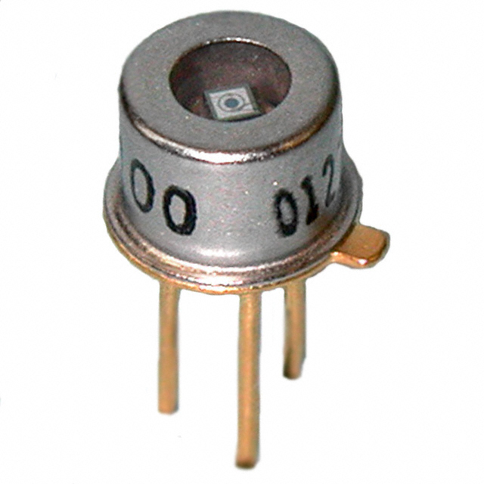
Avalanche Photodiode
Must be operated under high voltage (100V+)
Very sensitive photo-receiver
Advantages include:
Exploits the avalanche multiplication process for added gain
Ideal for a rangefinder
High speed operation
High quantum efficiency
Design considerations:
Terminal capacitance
Sensitive to ambient temperature changes
Exhibit measurable dark current

Slide 17
APD Selection
Main selection aspects included:
Low bias operation
Peak spectral sensitivity
Low price
Max dark current
Temperature coefficient
Selected mid-range Hamamtsu S2381
Manufacturer | Part Number | Active area mm | Peak wavelength (λ) nm | Peak sensitivity (A/W) | Max dark current (nA) | Temperate coefficient (V/°C) | Typical breakdown voltage (V) | Unit Price $
Hamamatsu | S9251-05 | 0.5 | 860 | 0.52 | 2 | 1.85 | 250 | 91.00
Hamamatsu | S9251-02 | 0.2 | 860 | 0.52 | 1 | 1.85 | 250 | 83.00
Hamamatsu | S6045-02 | 0.5 | 800 | 0.5 | 1 | 0.4 | 200 | 100.00
Hamamatsu | S6045-01 | 0.2 | 800 | 0.5 | 0.5 | 0.4 | 200 | 91.00
Hamamatsu | S5139 | 0.5 | 800 | 0.5 | 1 | 0.65 | 150 | 83.00
Hamamatsu | S2383-10 | 1.0 | 800 | 0.5 | 2 | 0.65 | 150 | 136.00
Hamamatsu | S2382 | 0.5 | 800 | 0.5 | 1 | 0.65 | 150 | 83.00
Hamamatsu | S2381 | 0.2 | 800 | 0.5 | 0.5 | 0.65 | 150 | 76.00
Pacific Silicon | TO52-S1 | 0.5 | 900 | 0.6 | 1.5 | 1.55 | 200 | 93.10

Slide 18
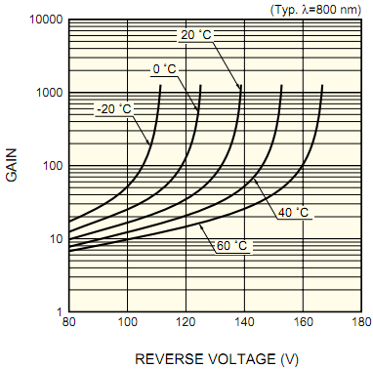
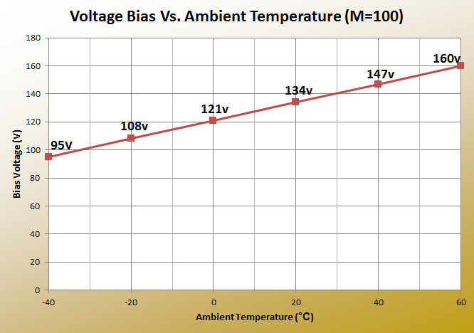
Temperature effects on S2381
As the ambient temperature increases, the voltage required to maintain constant gain must increase.
We are operating with M at 100.

Slide 19

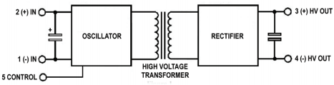
High Voltage DC-DC Converter
Decided to buy pre-made converter instead of building our own due to size goal.
Emco Q04 outputs 60-400V
Maximum output current of 1.25mA
Peak-peak output ripple less than .1%
Draws less than 100mA under full load at 12v input voltage.
As a cube of only 0.5 inches and a weight of just over 4 grams, the Q04 is ideal for portable applications.

Slide 20
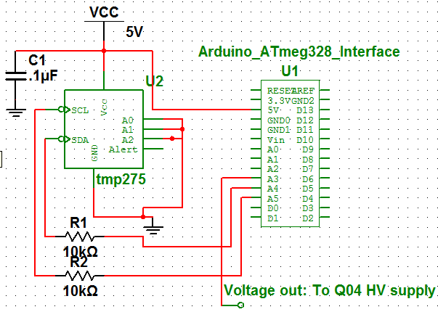
Ambient Temperature Adjust
Control pin on HV supply must be adjusted to maintain constant gain.
Tmp275 – Digital output temperature sensor will be used to detect ambient temperature.
Eight addresses
Two wire serial interface using I2C
Capable of reading temperatures with a resolution of 0.0625°C
Temperature range of -40 to +125°C
As ambient temperature changes, analog output from MCU will change from 0-5V; directly changing the HV output.

Slide 21
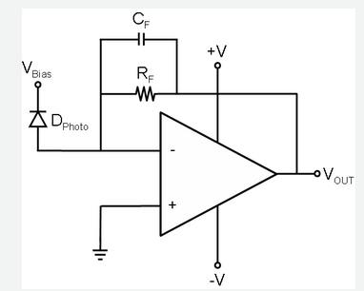


Transimpedance Amplifier
Requirements
Must be very low noise
Must provide acceptable gain
Vo max 5 volts pk-pk
High speed response
TI OPA847
BJT amplifier
High GBP: 3.9GHz
High slew rate 950V/us
Very low voltage noise of 0.85nV/√Hz
Since feedback capacitor is inversely proportional to resistance, an additional gain stage will be needed.

Slide 22
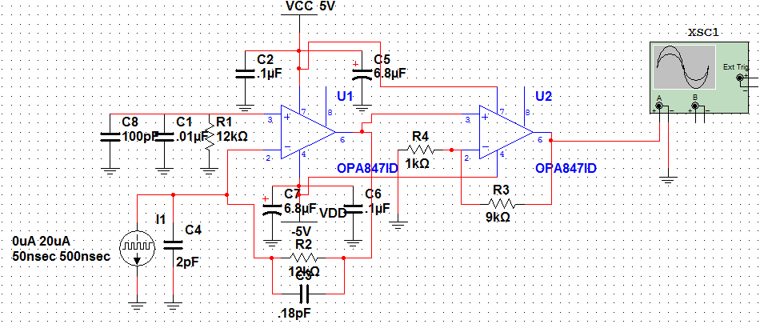

Circuit Schematic
Shown highlighted in yellow is a current source and input capacitance representing the APD.
Boxed in blue is the gain resistor of 12k and feedback capacitance used to control the frequency response.
The red box is the additional op-amp that serves as an extra gain stage to put the output voltage in the range of 1-5V.

Slide 23
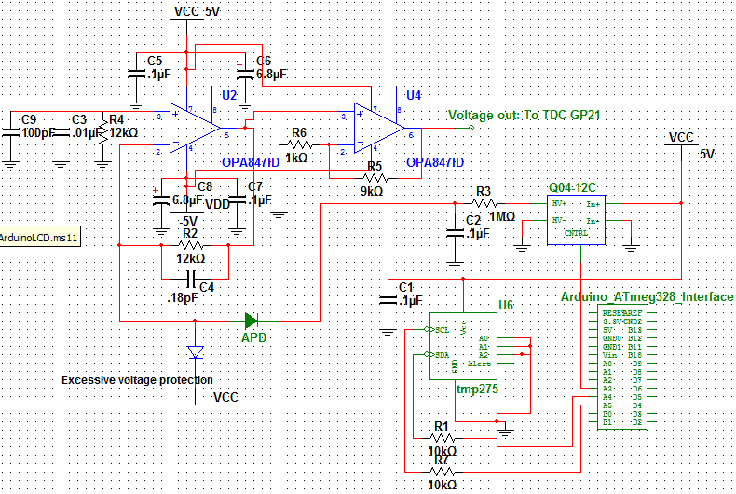
APD Module Schematic

Slide 24
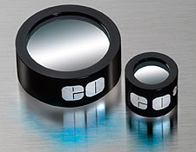
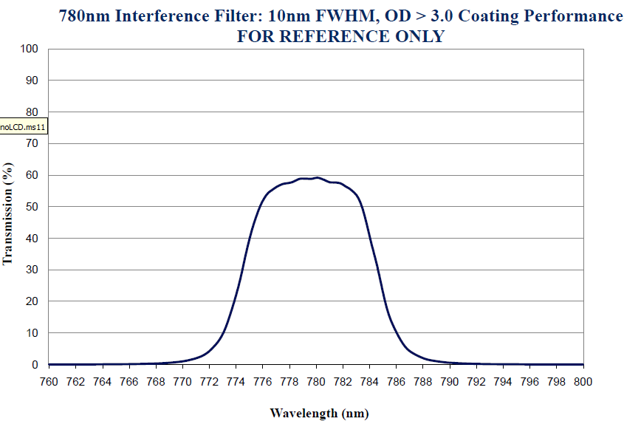
Infrared Optical Filter
Required to block out unwanted wavelengths from entering system.
IR band-pass filter from Edmund optics.
Diameter of 25mm
CWL of 780nm
Same as output laser.
With a Pass-band of only 10nm; the filter is very precise

Slide 25
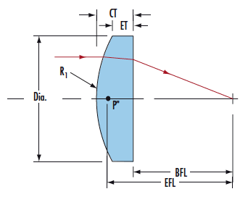
Laser Optics: PCX Lens
Edmund Optics: V-Coated 785nm
Maximum throughput at 785nm
Glass substrate, N-BK7 (RoHS compliant)
125mm Focal Length
Longer Focal Length = More intense focal point

Slide 26
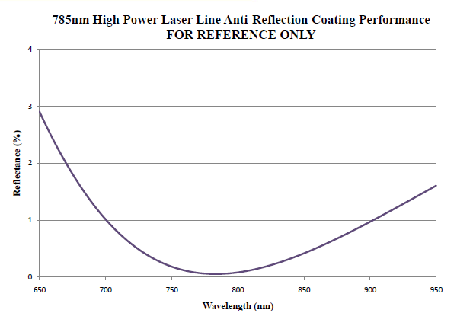

Slide 27
Range Measurement Hardware

Slide 28
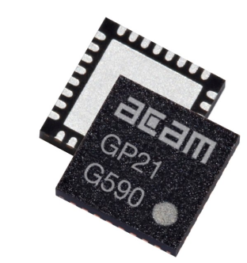
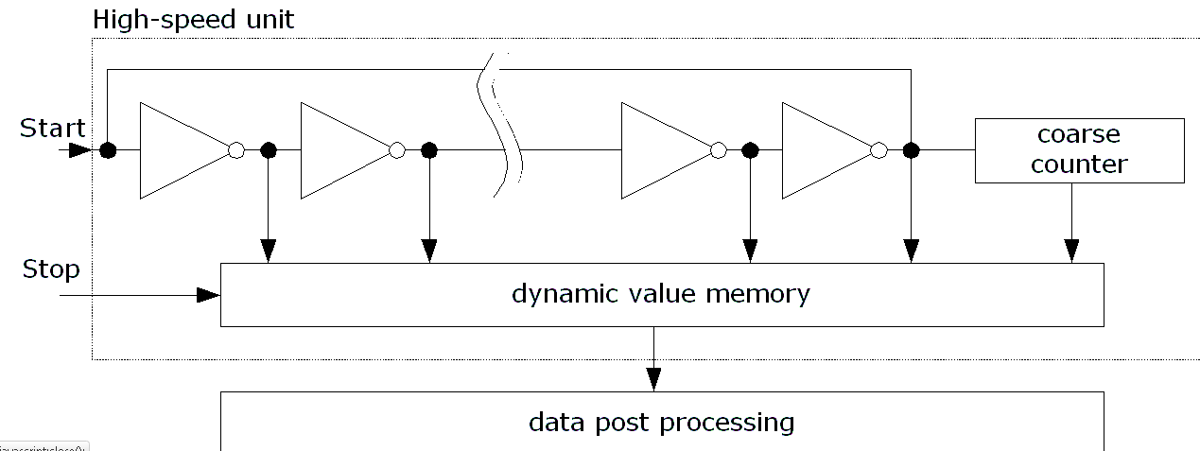
ACAM TDC-GP21
Time to Digital Converter
Measures the time difference between 2 signals
Capable of implementing TOF laser ranging due to redundant circuitry and propagation delays.
Multiple clock signals capable of measuring 3ps intervals (3 mm)
QFN 32 package
SPI communication
Fire Pulse Generator
Output tied to laser module and START channel
Cost effective: $40.00 for a large increase in range

Slide 29
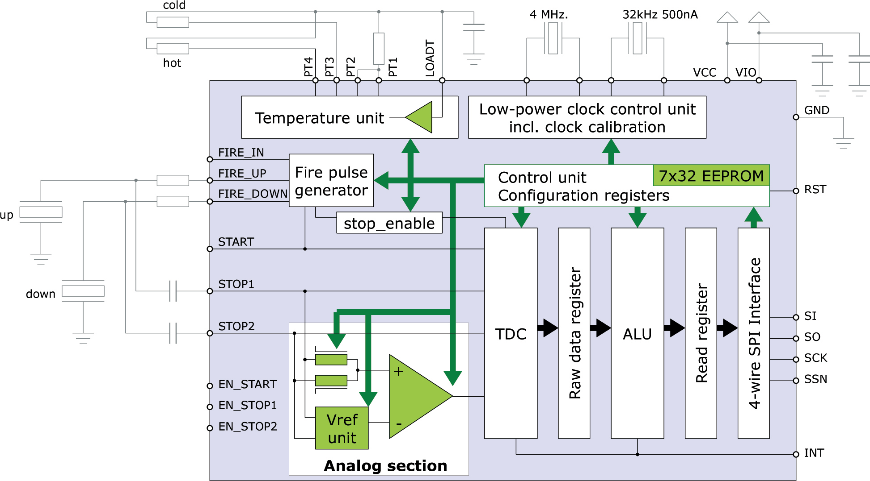
ACAM TDC-GP21

Slide 30
ATmega328 & Arduino Uno Board
13 digital GPIO pins
6 analog input pins
Can serve as digital GPIO
16 MHz Crystal Oscillator
5V and 3.3V output perfect for prototyping
Price: $35.00
SPI and I2C compatible

Slide 31
Arduino Uno Environment
C-based programming
SPI Library (GP21 Communication)
I2C Library (TMP 275 Ambient Temp Sensor)
LCD Library (Hitachi HD 44780)
Extensive Support Community
Online Tutorials
Limitations with SPI communication require new functions to be written

Slide 32
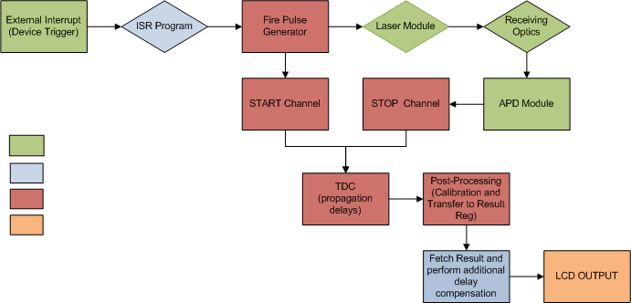
Ranging Process Flow
= External
= ATmega328
= GP21
= LCD

Slide 33
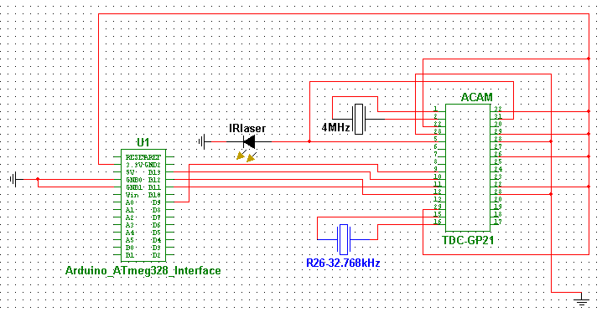
Arduino-GP21 Prototyping
4 Wire SPI connection
Declare new Slave Select Line for GP21
3.3V Supply from Arduino to TDC

Slide 34
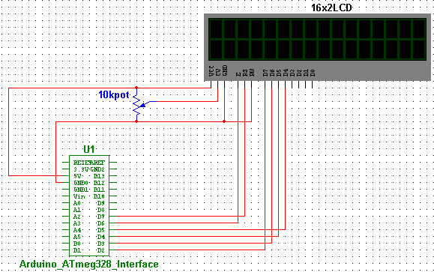
LCD Prototyping
4 Wire interface for data transfer (D2-D5)
2 Wire interface for Enable and R/W configuration (D6-D7)
5V supplied by Arduino to power LCD and backlight

Slide 35
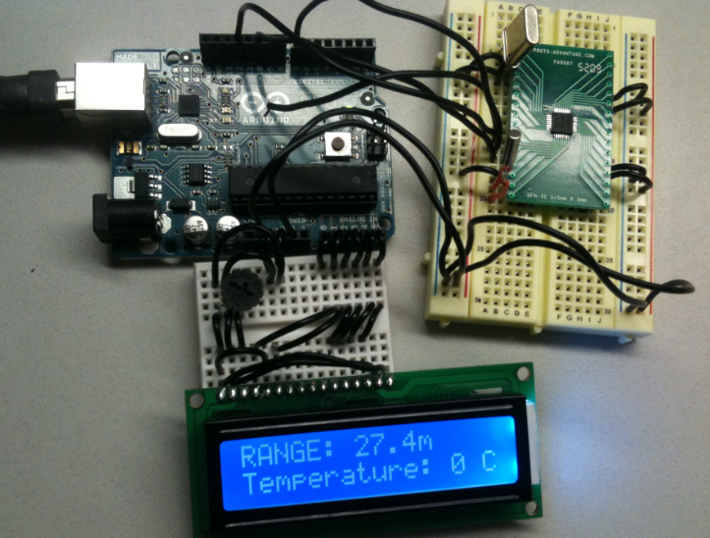
Prototyping GP21, Arduino, LCD
LCD: Fully Functioning
GP21: Re-writing the functions needed to communicate with the registers including:
readReg()
writeReg()
TOeeprom()
FROMeeprom()
readResult()
fetchStatus()

Slide 36
Contactless IR Temperature Sensor

Slide 37
IR Temperature Function
Temperature need to be control and monitor engineering application like cooling, heating, drying, and storage.
Increase ability portable sensing field device by giving temperature measuring function.
Considered methods:
* Mechanical
* Thermo-junctive
* Thermo-resistive
* Infrared radiation
Infrared radiation

Slide 38
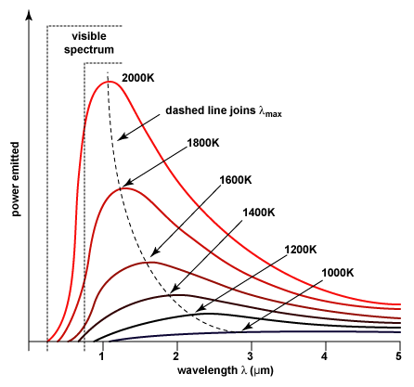
Infrared Radiation - Reasons
Noncontact measurement
Require small energy
Long wavelength –makes infrared radiation transmitted better through various medium.
It could emit to all kinds of bodies.

Slide 39
Infrared Detection
INFRARED SOURCE
DETECTOR
ANALOG TO DIGITAL
LCD DISPLAY
SIGNAL PROCESSING

Slide 40
Detectors
Consider types:
+ Quantum: Expensive
+ Thermal:
Thermocouple
Thermopile
Bolometer
Micro Bolometer
* Thermopile:
Digital detector : MLX90614
Analog detector: MLX90247 , ZTP – 135SR

Slide 41
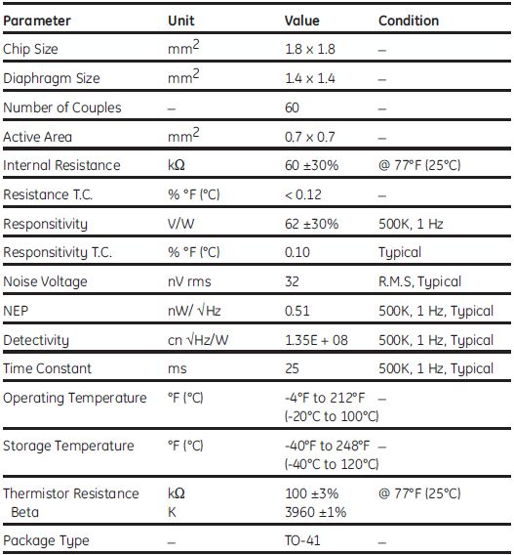
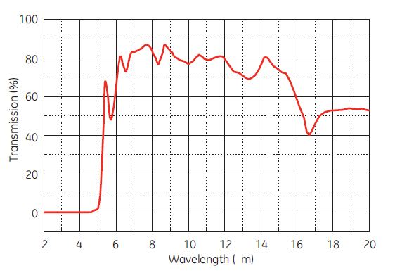
ZTP-135SR
Infrared wavelength: 5 цm to 15 цm

Slide 42
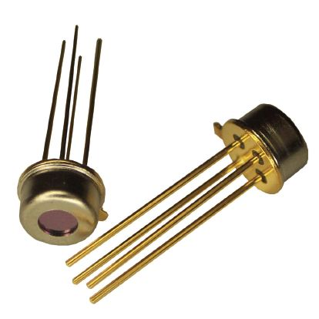
FEATURES
Small-size sensor (TO-46 package)
Included ambient temperature (thermistor) sensor for compensation
High sensitivity
Fast response time
Low cost
Consists of thermo-elements, flat IR filter
Thermistor of temperature compensation in a hermetically-sealed package.
Variety of filters available to help maximize performance in specific applications

Slide 43
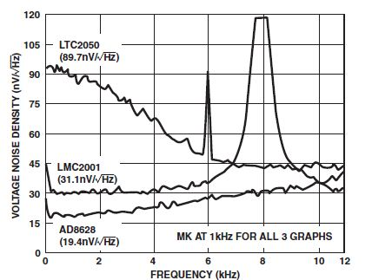
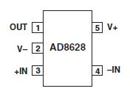
Op-amp Chopper – AD8628
Lowest Auto-zero Amplifier Noise
Low Offset Voltage: 1 цV
Input Offset Drift: 0.02 цV/C
Very Low Input Bias Current:
Low Supply Current: 1.0 mA
Overload Recovery Time: 10 цs
No External Components Required
Rail to Rail Input and Output Swing
5V Single-Supply Operation

Slide 44
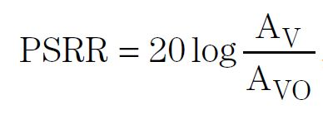
Op-amp Chopper – AD8628
High Gain where the PSRR: 100 dB
Close-loop gain: 40 dB
Gain 1000 times as applied AD8628
* ZTP- 135SR output: estimated around 3 to 5 mV
1000 X (3 – 5mV) = 3 to 5 V

Slide 45
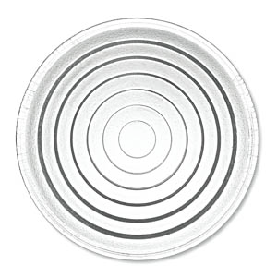
IR Thermometer Optics
Single Fresnel Lens made of HDPE
Salvaged from porch-light lens
Cost-Effective Vs. Germanium or Silicon
Commonly used in low-cost PIR sensors and IR temperature guns

Slide 46
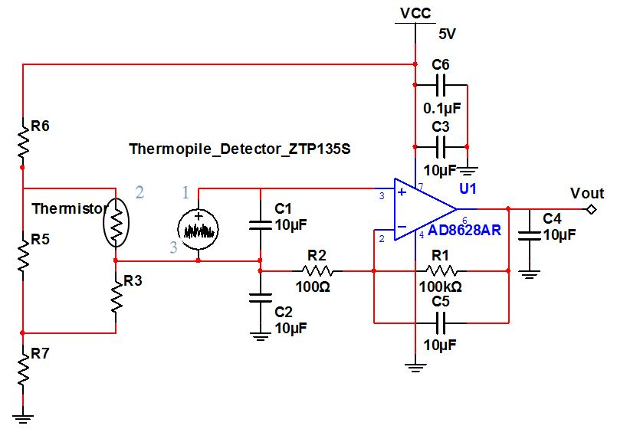
Schematics

Slide 47
Future Challenges
Frequency stability with of the transimpedance amplifier
Interfacing TDC to APD module
Quantifying the delay of the laser module startup
Properly mounting the lens and filter so that its focal point is on the APD
Possibly using a different LCD for increased user experience
Enclosure issues

Slide 49
Budget to Date
Name | Source | Cost | Purchased?
TDC-GP21 (QFN) | Transducers Direct | $35.00 | yes
Arduino Dev Board: | Element 14 | $30.00 | yes
ATMEGA328
QFN32 Breakout Board | Proto-advantage | $13.99 | yes
780nm Laser Module | Aixiz | $13.00 | yse
16x2 LCD | Spark Fun | $13.95 | yes
Various Resistors | Anywhere | *$5.00 | yes
Various Capacitors | Anywhere | *$5.00 | yes
PCXOptical Lens - NT65-524 | Edmund Optics | $40.00 | yes
780nm Optical Filter - NT65-723 | Edmund Optics | $99.00 | yes
Li-ion 7.4V | Battery Junction | $25.00 | no
LM7805 +5V Regulator | Spark Fun | $1.25 | yes
LM7905 -5V Regulator | Fairchild Semiconductor | $0.60 | yes
LD1117 3.3V Regulator | Spark Fun | $1.95 | yes
TMP275 temperature sensor | TI | 4.25 (sampled)
ZTP-135S - IR SENSOR | Element 14 | $19.95 | yes
Fresnel Lens | N/A | Salvaged | yes
S2381 APD | Hamamatsu | $76.00 | yes
Emco Q04 DC - HV DC | Emco | $59.00 | yes
OPA847 Op-amp x4 | TI | *$10.00 (sampled) | yes
Total |  | $428.69

